Slide 1


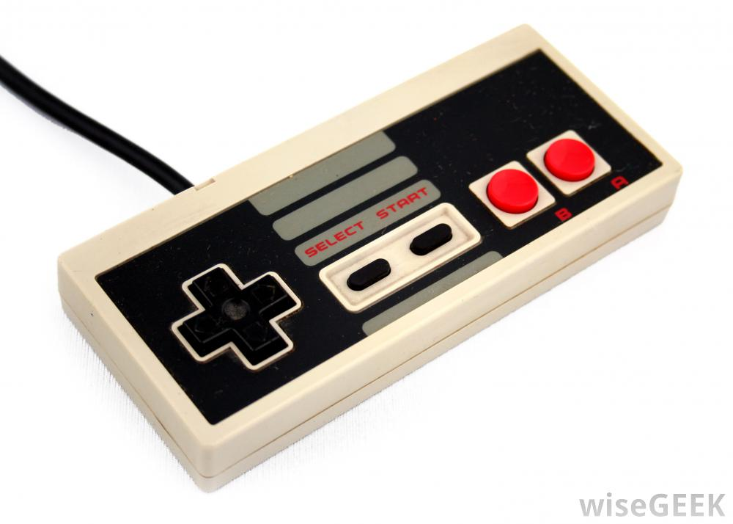
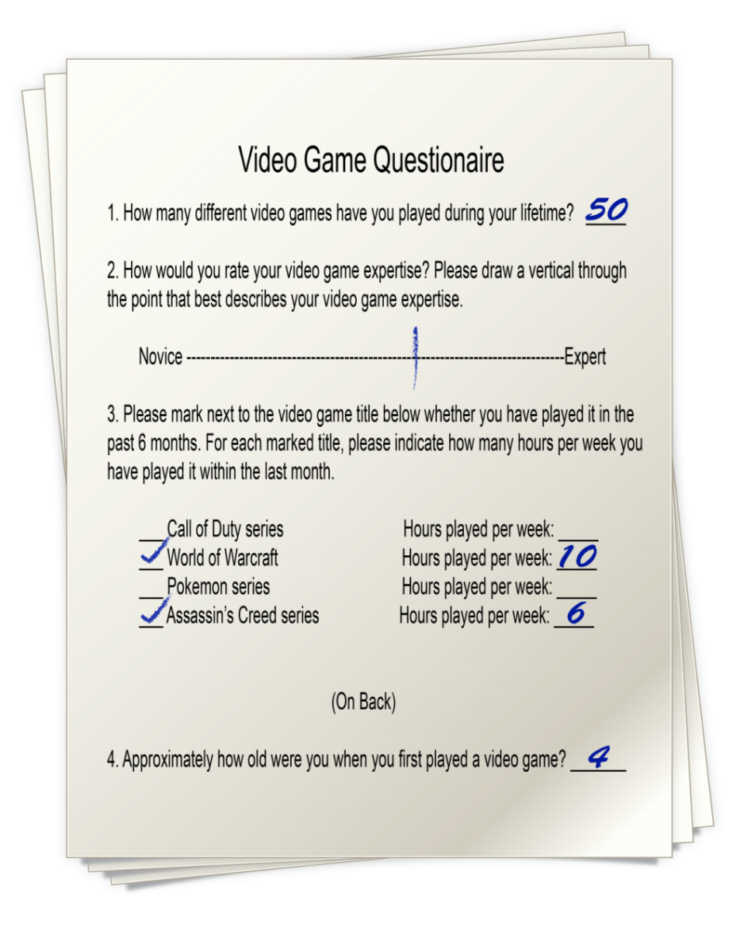
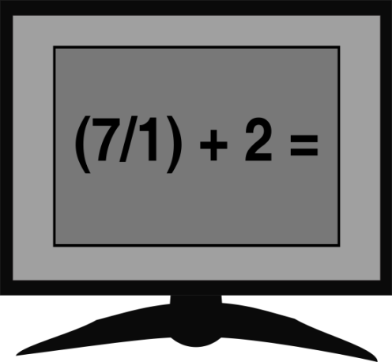
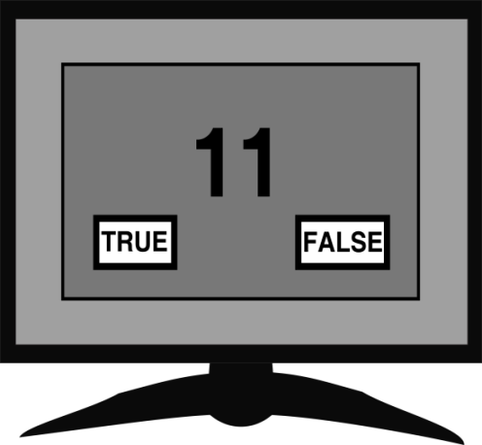
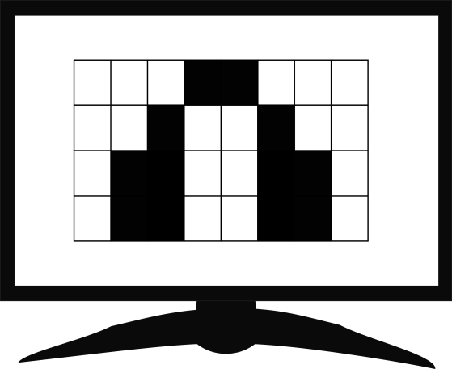
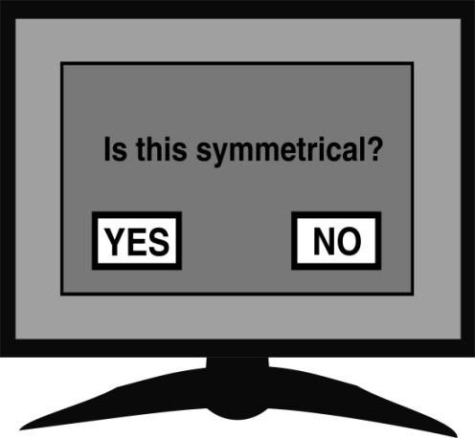
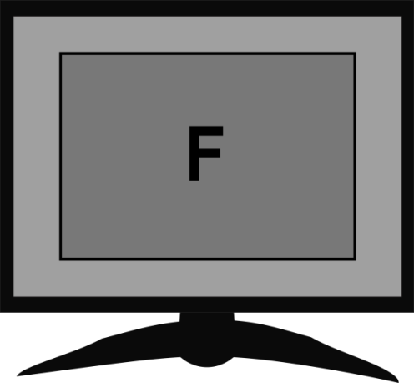
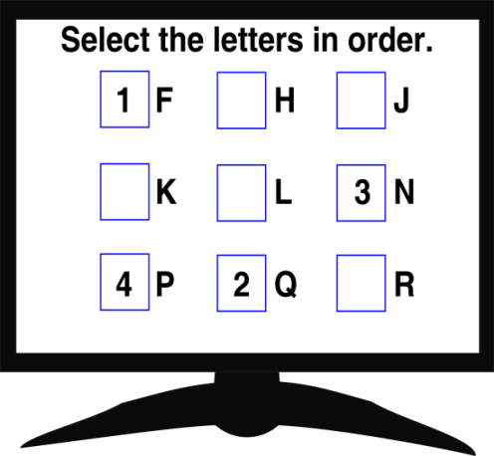
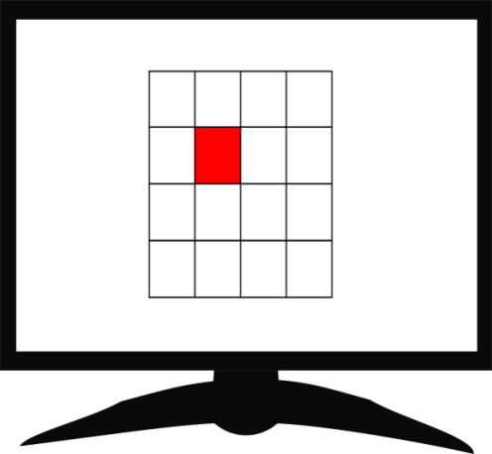
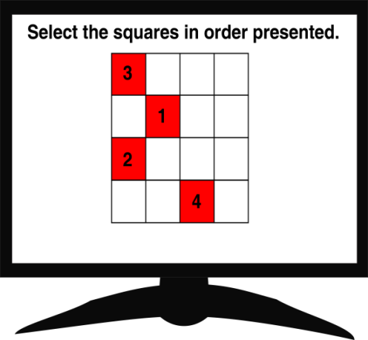







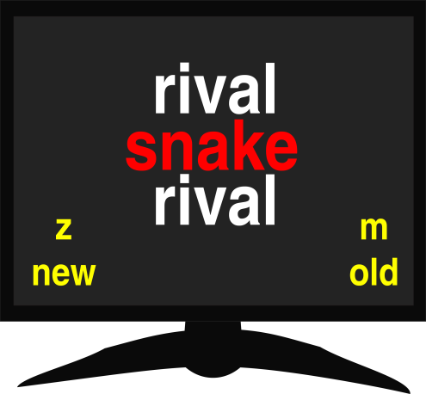

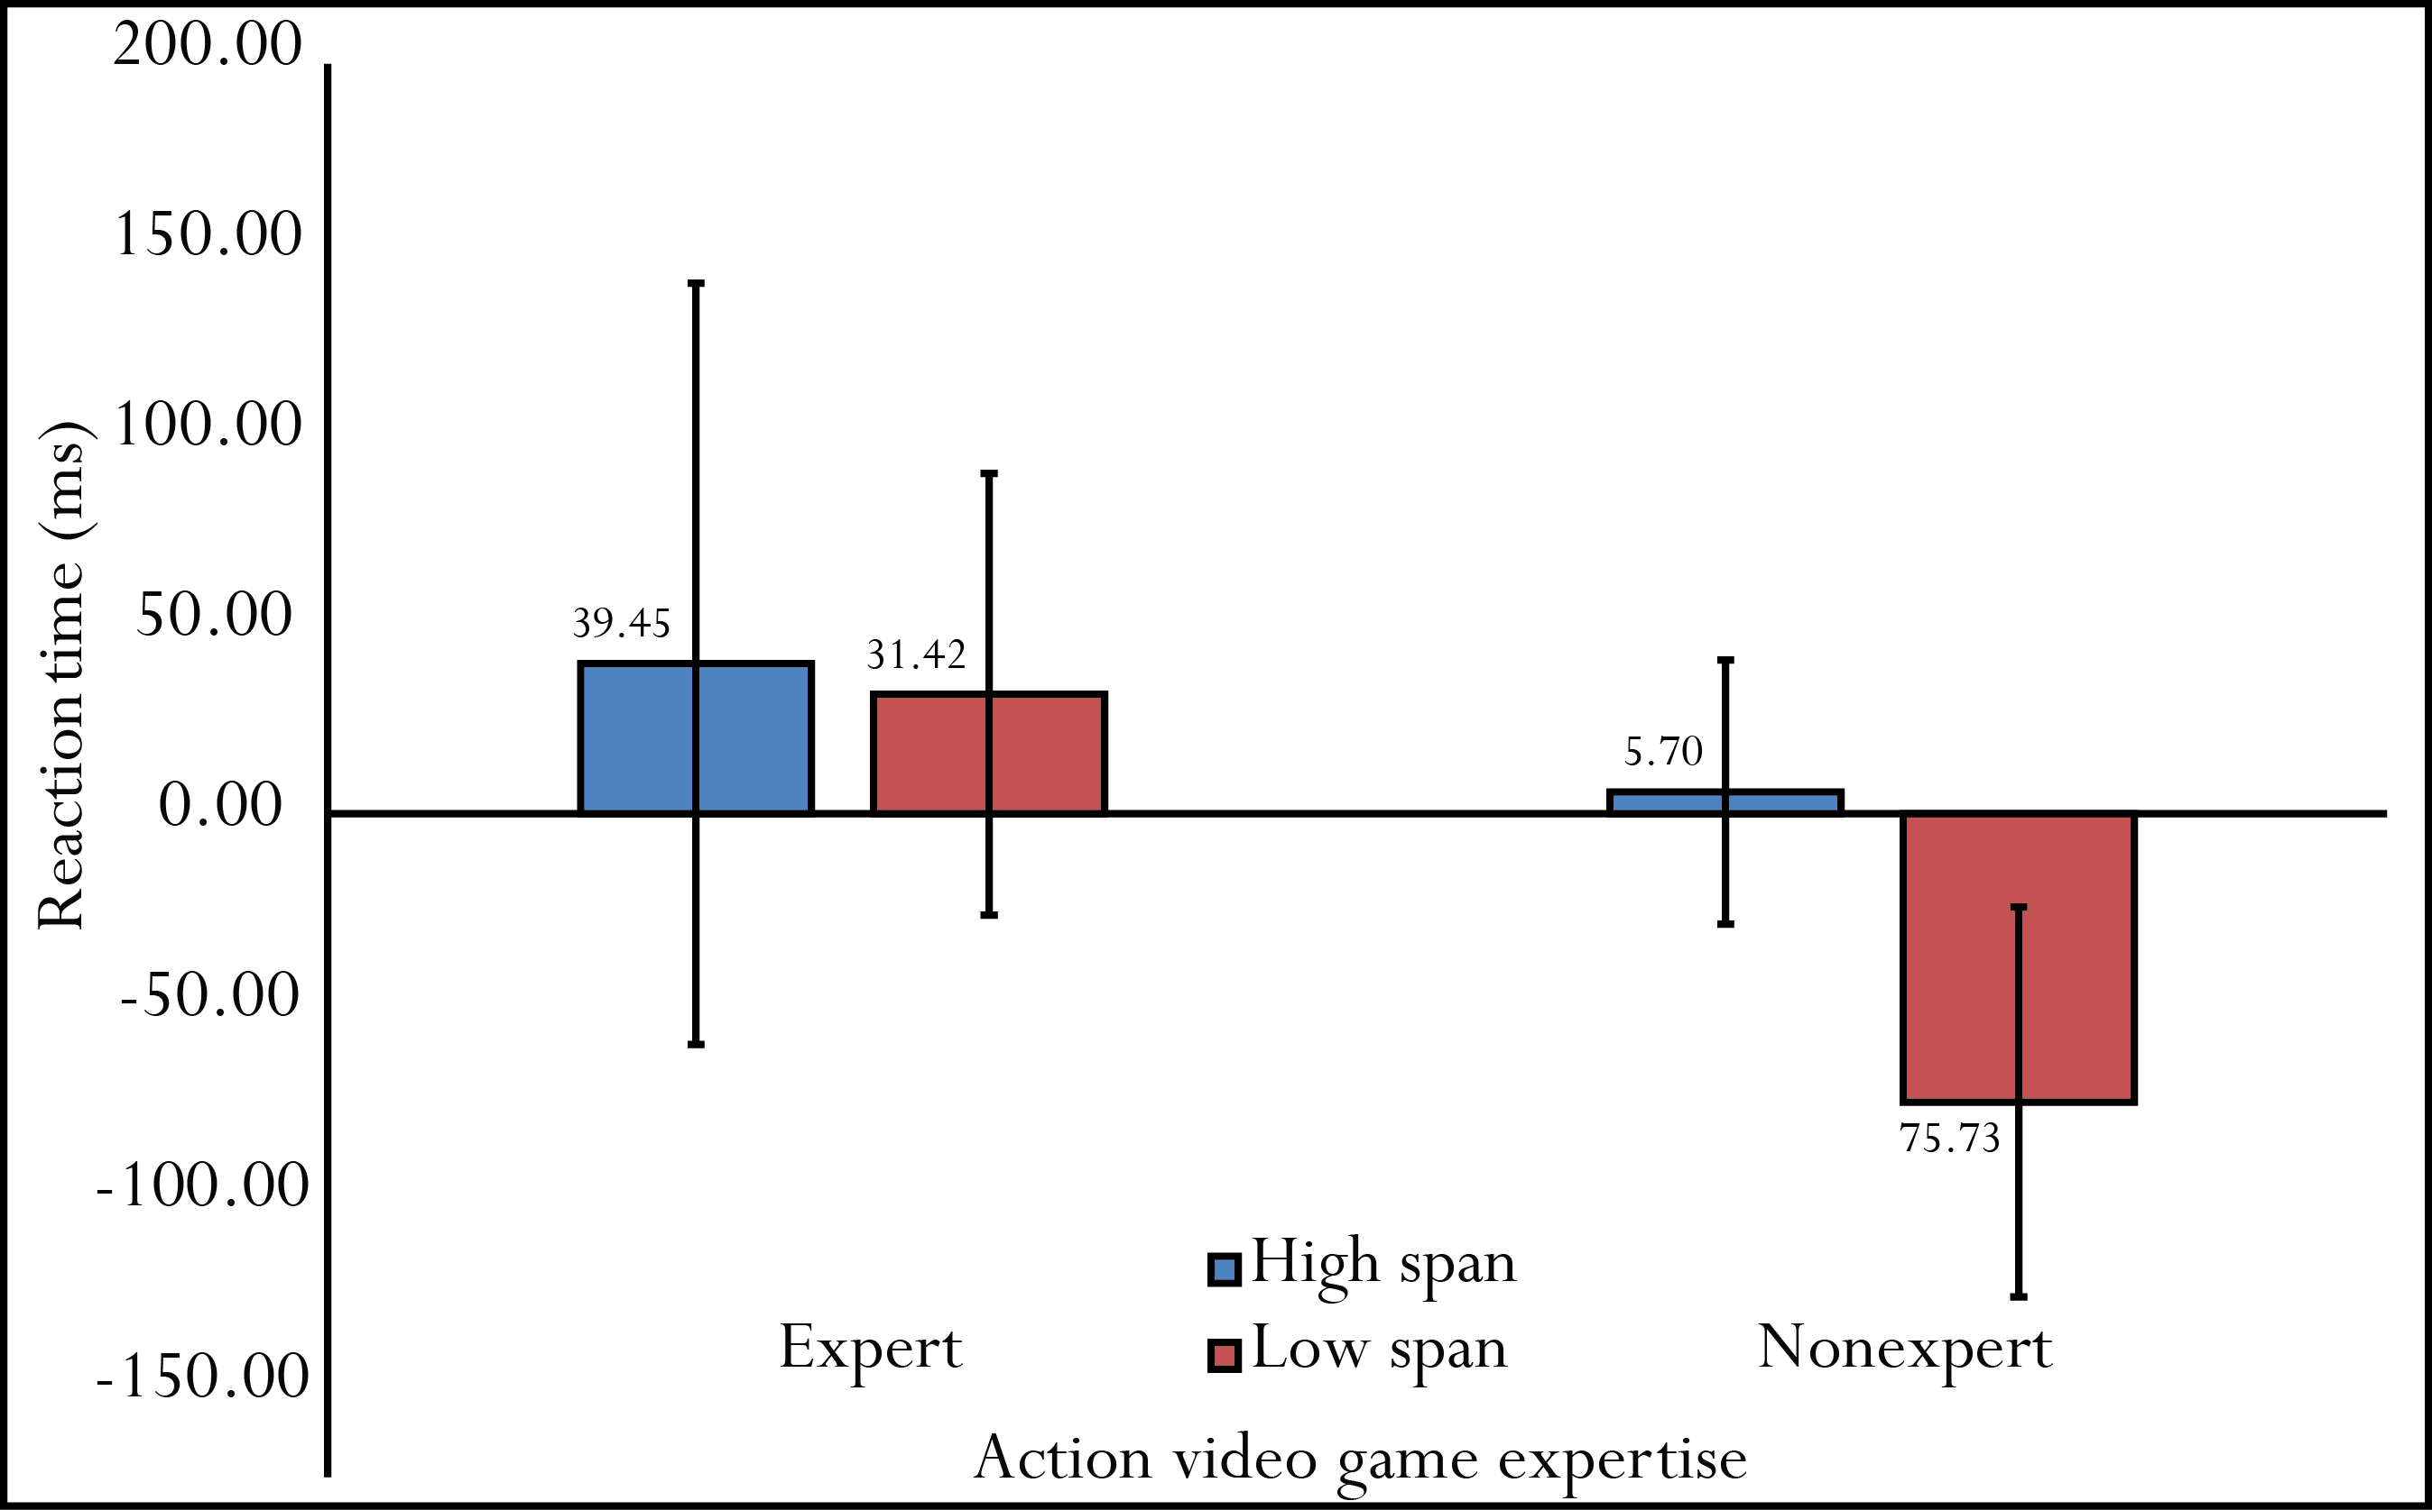
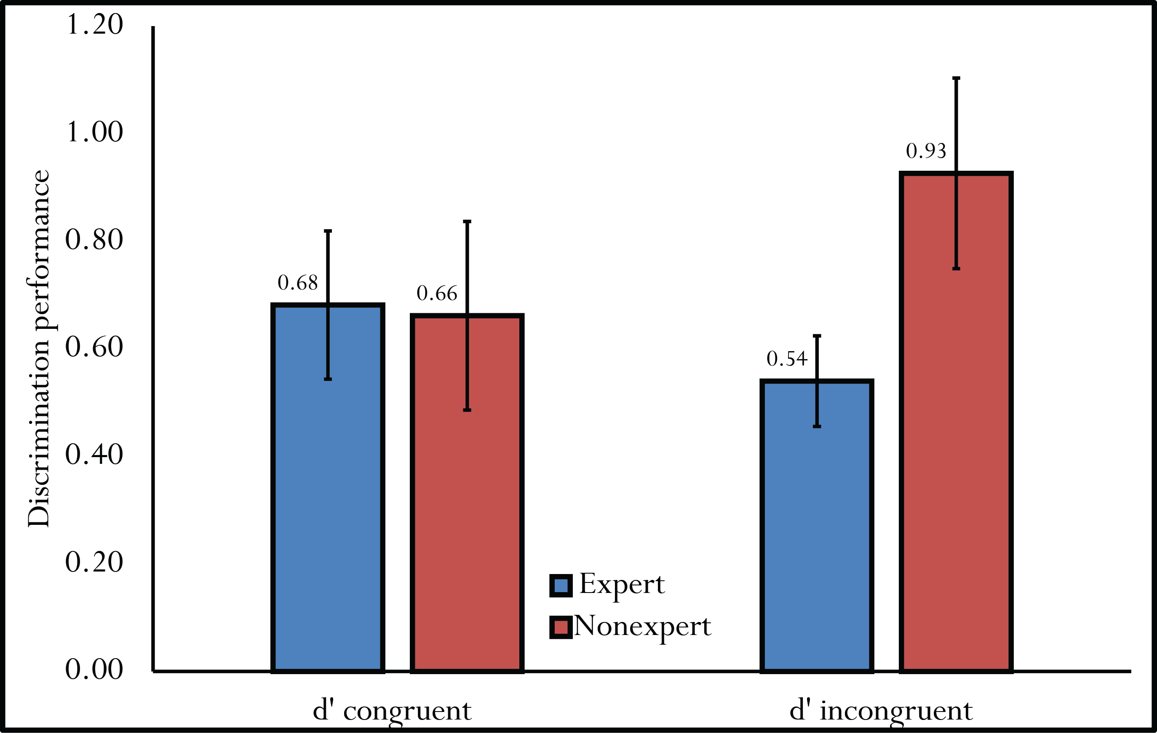
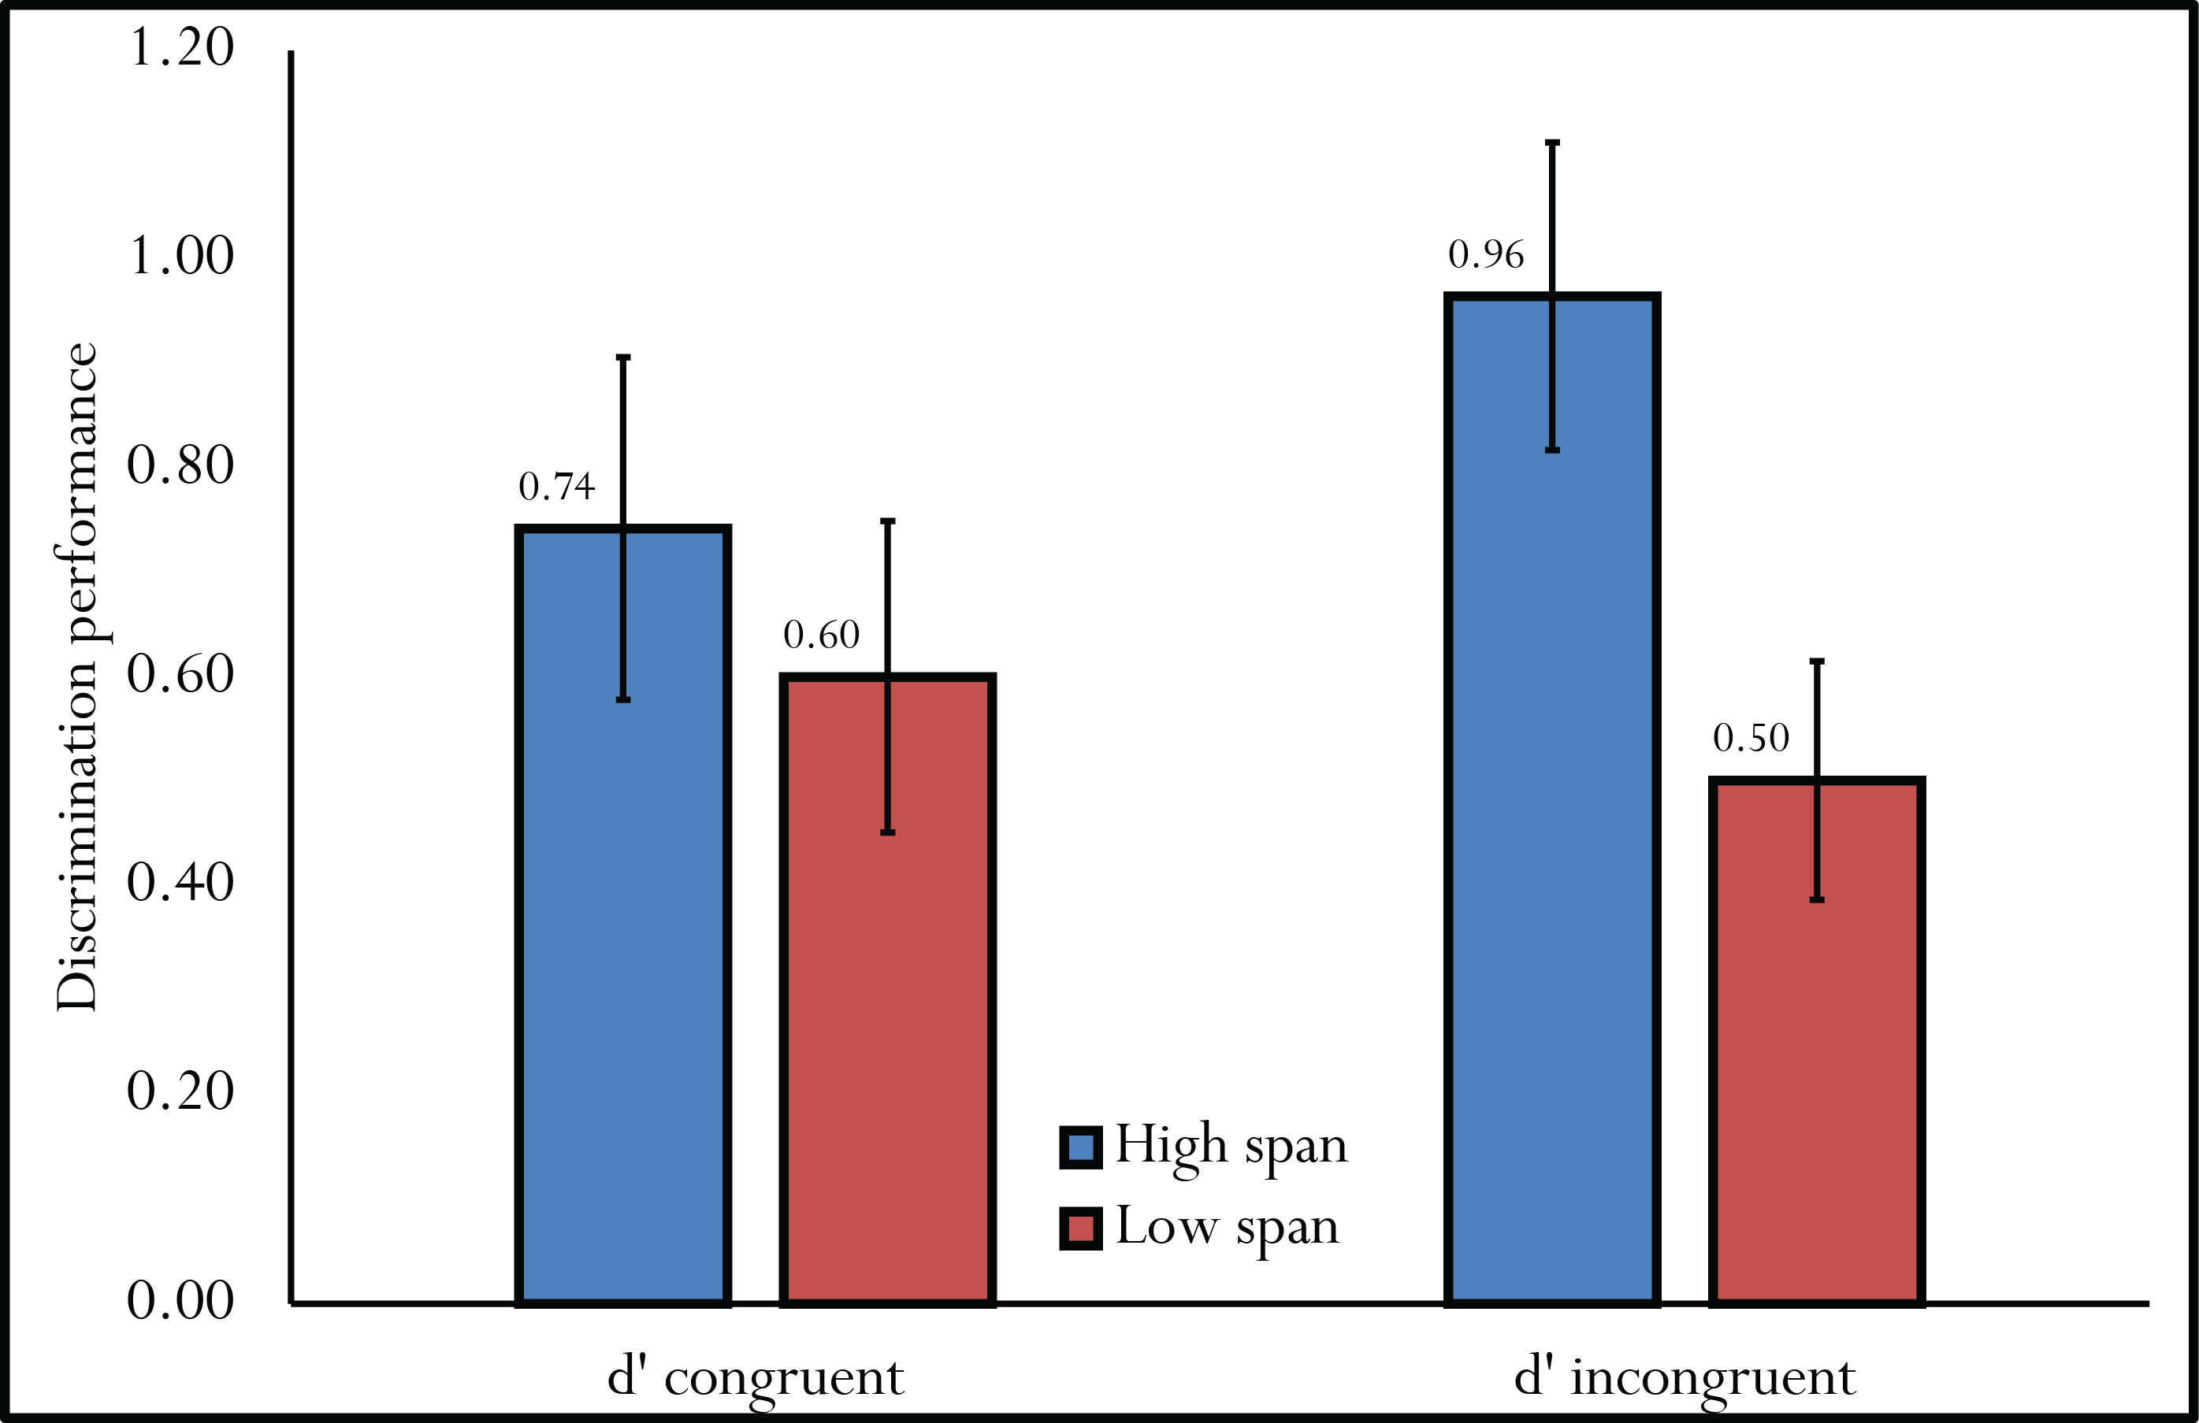
The spread and control of attention of action
video game experts in a memory flanker task
Human
Memory
Lab
Laila P. Davis, Caleb J. Picker, & Colleen M. Parks, PhD
Design
Working Memory
OSPAN
SSPAN
Introduction
Research Question
Do action video game experts have better control of attention than nonexperts, and does this control relate to inhibiting distracting information in a long-term memory task (Kane & Engle, 2000; Oberauer, 2005; Ste-Marie & Jacoby, 1993; Yonelinas, 2002)?
What we know
Action video game experts have greater accuracy than nonexperts in secondary tasks but not primary tasks, indicating control of attention in simple decision tasks (Chiappe et al., 2013), but results are inconsistent (Donohue et al., 2012)
Action video game experts are better than nonexperts in some tasks requiring attentional control (e.g., Blacker & Curby, 2013)
Predictions
Control of attention: Action video game experts may be less susceptible to influences of distracting information than nonexperts because they may exert better attentional control (e.g., Kane & Engle, 2000)
Memory Flanker Task
120 Words
2s + 1s ISI
STUDY
TEST
“5…6…7”
Divided
Attention
Task
Congruent
Old
Congruent New
Incongruent
Old
Incongruent
New
Results
Flanker Effect
Discussion
IV₁: Action video game expertise (Expert x Nonexpert)
IV₂: Working memory span (High span x Low span)
DVs: Flanker effect (median RT), d’ congruent, d’ incongruent
$$\frac{\left({RT}_{old, incon}− {RT}_{old, con}\right)+\left({RT}_{new, incon}−{RT}_{new, cong}\right)}{2}$$
Action video game expertise
Action video game experts had worse discrimination under incongruent conditions than nonexperts, perhaps due to a wider spread of attention (Dye, Green, & Bavelier, 2009)
Expert and nonexpert discrimination were similar with congruent flankers, suggesting that worse incongruent discrimination is not due to an overall inability to discriminate
Working memory span
High spans had better discrimination under incongruent conditions than nonexperts, perhaps due to a better control of attention (Kane & Engle, 2000)
High and low spans had similar discrimination with congruent flankers, suggesting that low span’s worse incongruent discrimination is not due to overall inability to discriminate
Future studies
Obtain flanker effect by replicating original memory flanker procedures (tests underway; Ste-Marie & Jacoby, 1993)
Action video game training study for causal inferences
Overall test
Main effect of working memory span on combination of DVs
F(3, 40) = 5.699, p < .01, η_{p}² = .299
Main effect of action video game expertise on combination of DVs
F(3, 40) = 4.722, p < .01, η_{p}² = .262
Follow-up tests α/3 = .017
Action video game expertise and working memory span
Fs(1, 42) < 1 to 1.179, ps > .05, η_{p}²s = .011 to .027
Action Video Game Expertise
Working Memory Span
$$d^{′}= z[p\left("old" | old\right)]−z[p\left("old" | new\right)]$$
References
Blacker, K., J. & Curby, K. M. (2013). Enhanced visual short-term memory in action video game players. Atten Percept Psychophys, 75, 1128-1136. doi: 10.2758/s13414-013-0487-0
Chiappe, D., Conger, M., Liao, J., Caldwell, J. L., & Vu, K., L. (2013). Improving multi-tasking ability through action videogames. Applied Ergonomics, 44, 278-284.
Donohue, S. E., James, B., Eslick, A. N., & Mitroff, S. R. (2012). Cognitive pitfall! Videogame players are not immune to dual-task costs. Atten Percept Psychophys, 74, 803-809. doi: 10.3758/s13414-012-0323-y
Dye, M. W. G., Green, C. S., & Bavelier, D. (2009). The development of attention skills in action video game players. Neuropsychologia, 47, 1780-1789. doi: 10.1016/j.neuropsychologia.2009.02.002
Kane, M. J. & Engle, R. W. (2000). Working-memory capacity, proactive interference, and divided attention: Limits on long-term memory retrieval. Journal of Experimental Psychology: Learning, Memory, and Cognition, 26, 336-358. doi: 10.1037//0278-7393.26.2.336
Oberauer, K. (2005). Binding and inhibition in working memory: Individual and age differences in short-term recognition. Journal of experimental psychology: General, 134, 368-387.
Ste-Marie, D.M. & Jacoby, L. L. (1993), Spontaneous versus directed recognition: The relativity of automaticity. Journal of Experimental Psychology: Learning, Memory, and Cognition, 19, 777-788.
d' congruent: F < 1, η_{p}² = .000
d' incongruent: F(1, 42) = 7.699, p < .01, η_{p}² = .155
d' congruent: F < 1, η_{p}² = .018
d' incongruent: F(1, 42) = 11.064, p < .01, η_{p}² = .208
Presented at UNLV PSI CHI Poster Competition 2014

